Slide 1
IE2010 – Digital Electronics
Assignment 2020
Basics in PCB Construction

Slide 2
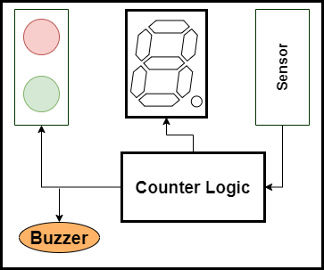
Assignment Task
Construct a digital circuit for an elevator which can carry a maximum of 9 people.
Use a digital IR sensor to detect a person.
The people count must be displayed on a single seven segment display.
The green LED must turn on if the people count is less than 9 and the red LED and a buzzer must turn on if the people count is more than or equal to 9.

Slide 3
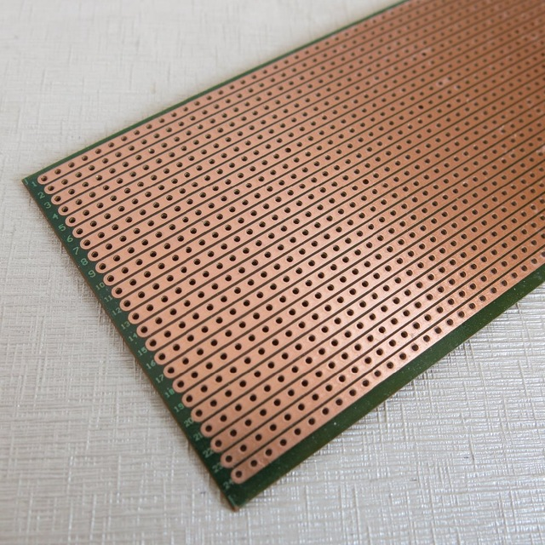
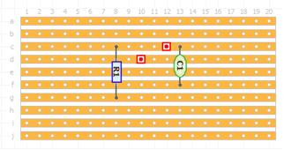
Circuit Boards
Veroboard

Slide 4
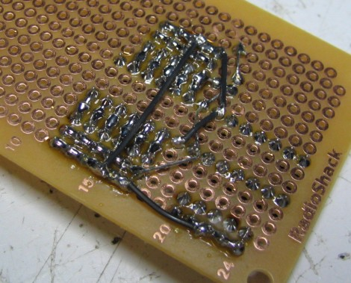
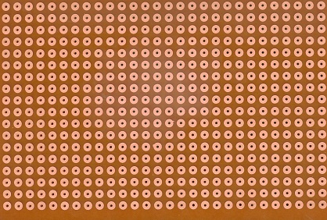
Circuit Boards
Dot Board

Slide 5
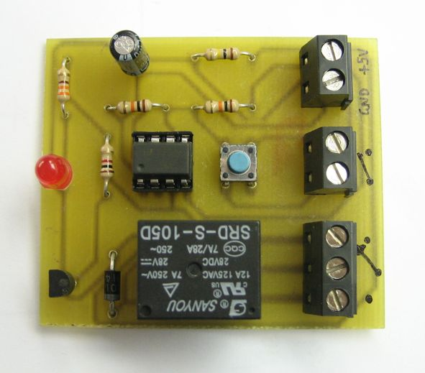
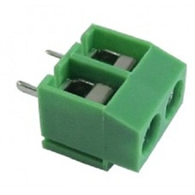
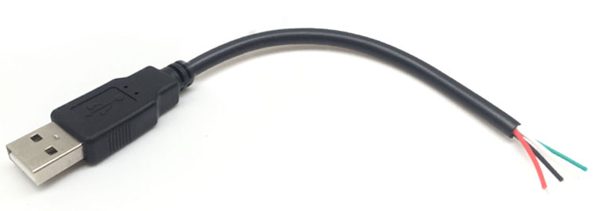
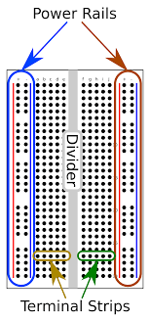
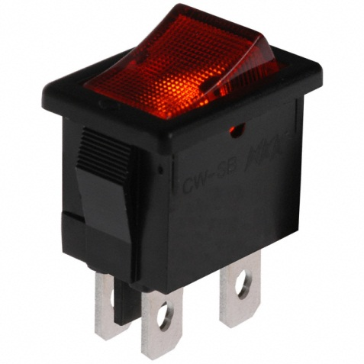
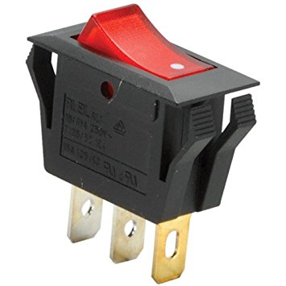
Power Supply to PCB
PCB Connectors
Power Switch
Rocker Switch

Slide 6
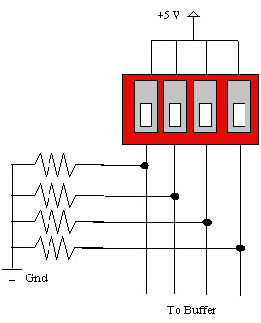
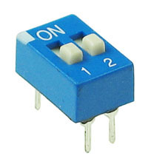
DIP Switches and Pull Down Resistors
Pull down resistors are used with dip switches to avoid floating input pins.
1kΩ Resistors are typically used as pull down resistors.

Slide 7
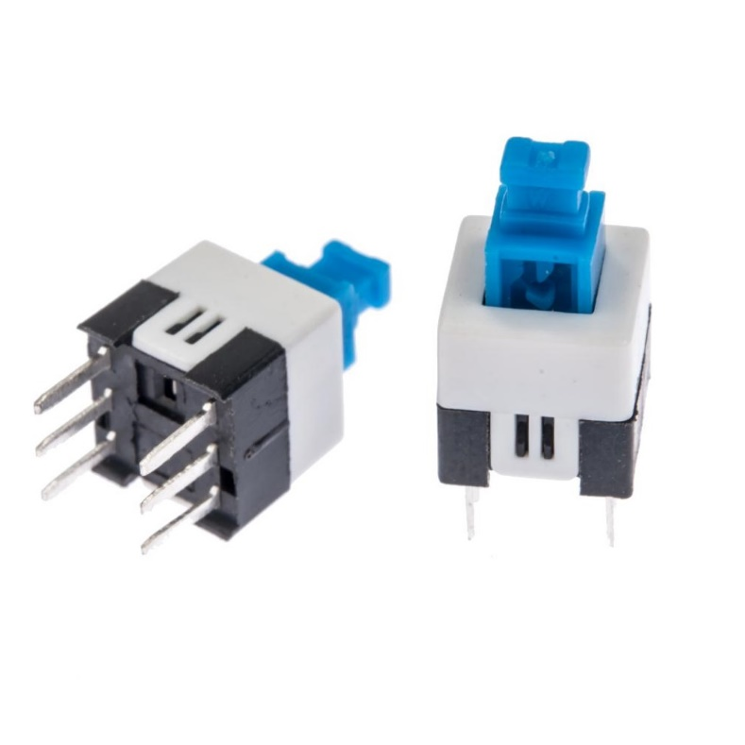
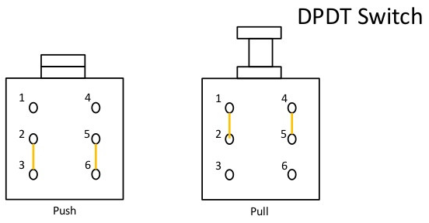
Self Locking Push Button
A Self locking push button has 6 pins.
There are two independent switches inside.

Slide 8
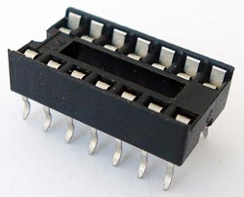
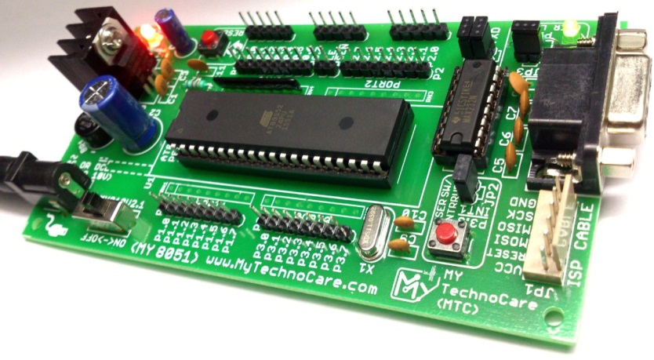
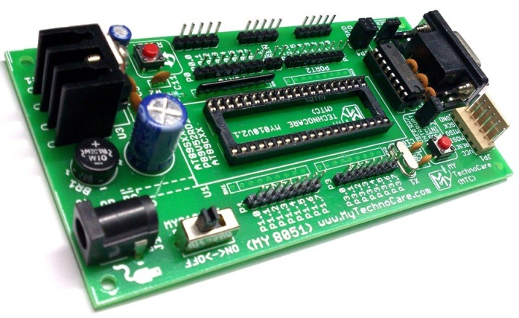
IC Base

Slide 9
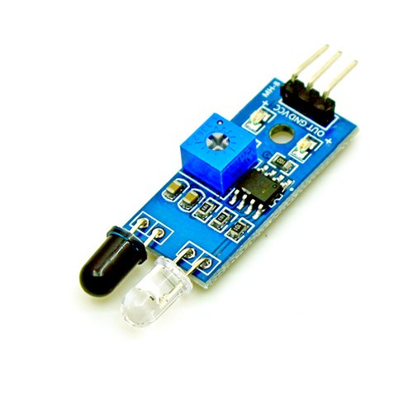
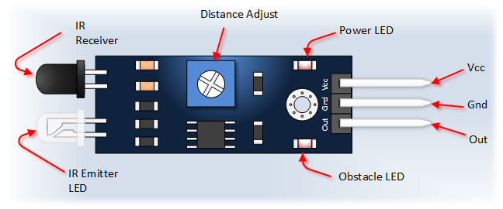
IR Sensor
IR Sensor has 3 pins
Vcc – 5V
GND – 0V
Output Pin – giving 1 or 0

Slide 10
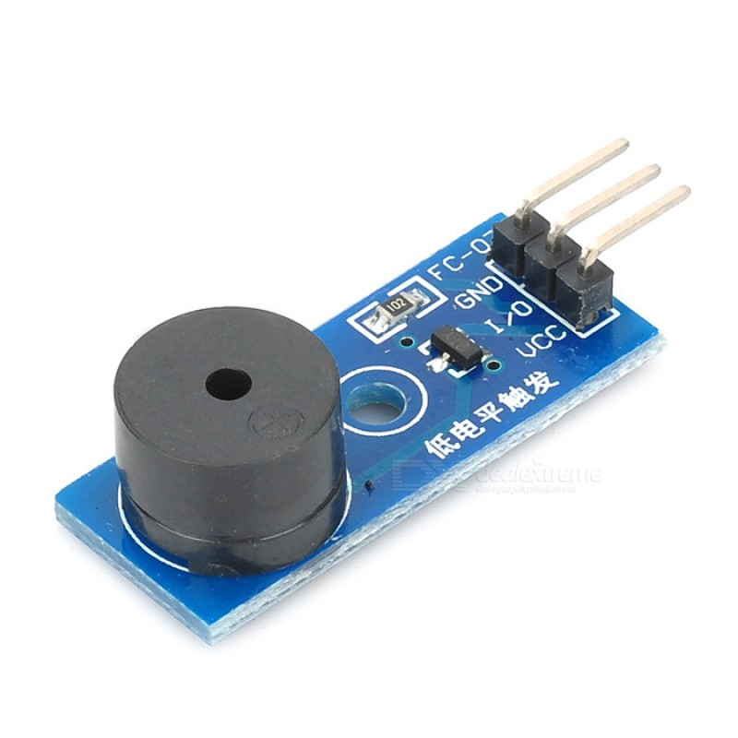
Buzzer Module
Buzzer module has 3 pins
Vcc – 5V
GND – 0V
Input Pin – provide 1 or 0

Slide 11
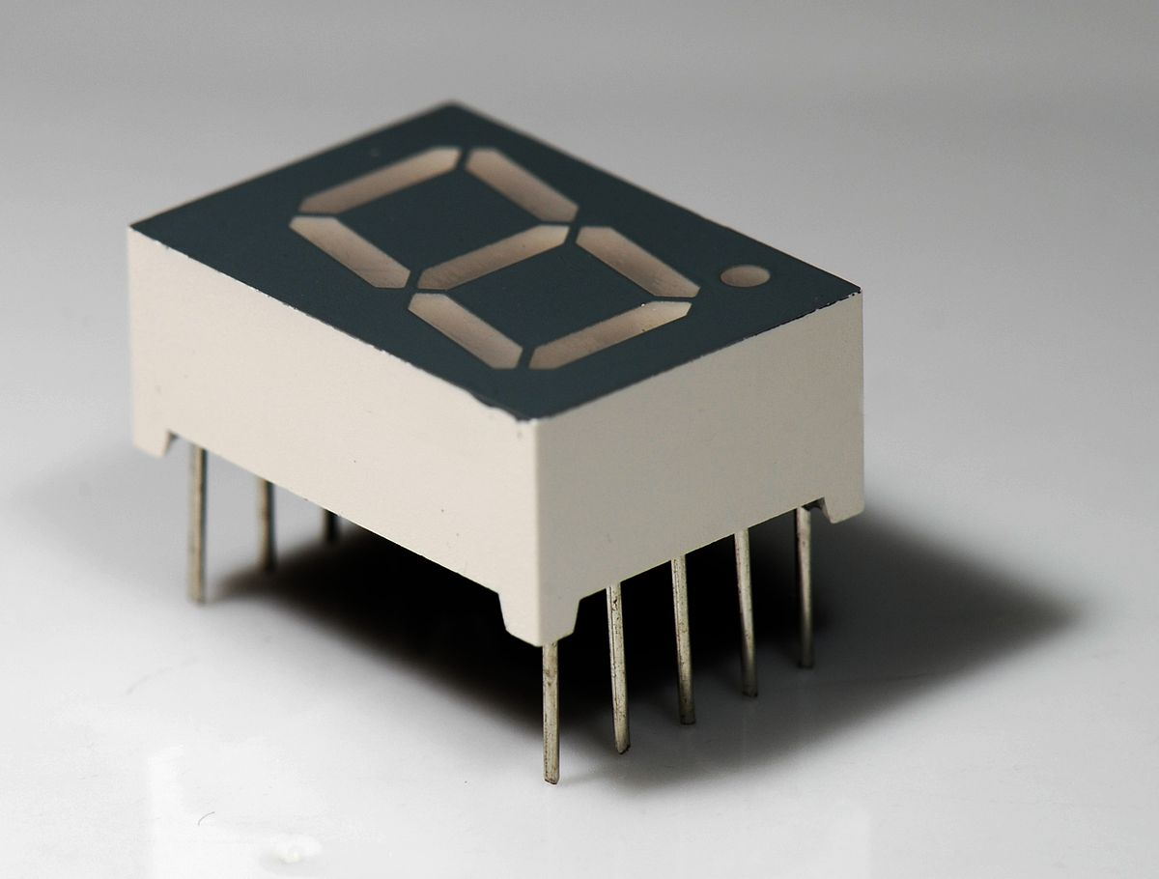
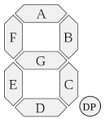
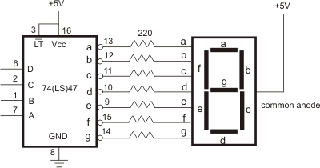
Seven Segment Display

